Slide 1
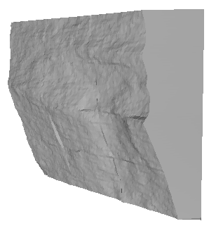
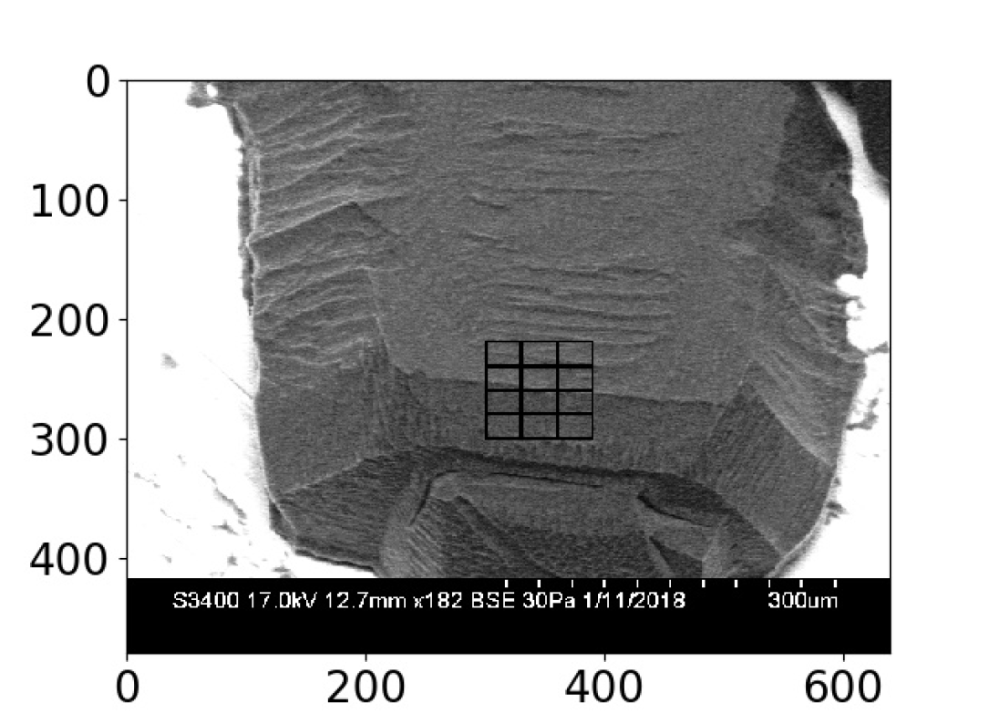
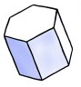
WELCOME!!

Slide 2
Cirrus clouds

Slide 5
LEARNING OBJECTIVES
ENHANCING KNOWLEDGE OF SCANNING ELECTRON MICROSCOPE
Backscatter Mode
Operation of the Cold Stage
DATA MANAGEMENT
Use of GitHub repository
Python coding to produce an .stl file for 3D printing and VR
CREATE A 3D PRINTED MODEL OF ICE CRYSTAL YOU’VE GROWN
END PRODUCT OF VR VIDEO SHOWCASING CRYSTALS

Slide 6
WHAT TO WRITE IN YOUR LAB NOTEBOOK…
The purpose of a lab notebook is to insure the science is repeatable
Upon reflection you should be able to look through your notebook and repeat exactly what you’ve done before
For SEM sessions:
Write down all conditions for the whole session
For each crystal note the current vacuum, equilibrium temp, current temp
For VR Sessions:
Notes on procedure of VR programs
Other situations:
Definitions on confusing terms
Notes on common python coding errors and their solutions

Slide 7
Surface Grid
h(x,y)
[.npz]
SEM IMAGES A-D [.bmp]
GNBF_Calibrate [.pynb]
GNBF_Retrieve [.pynb]
GNBF_Grid2stlwskirt [.pynb]
Boxes [.nml]
Calibration [.nml]
STL File
[.stl]
VR
3D Print

Slide 8
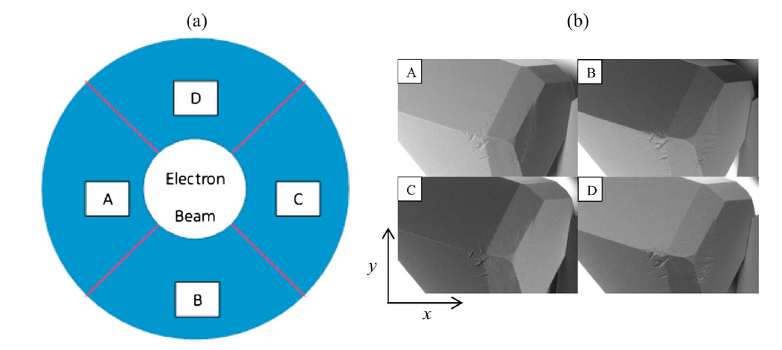
Butterfield et al. 2017
SEM Backscatter Detector Assembly
Images of the ice crystals as produced by each detector
Notes:
A electron beam is directed at the same where the electrons will interact with the molecular orbitals of the ice crystals before being bounced off. Returning electrons are captured by each detector independently at a set interval of roughly 4 seconds per image producing four near-simultaneous images of the surface as shown on the right. These images are constructed of pixels to which a value of backscatter intensity can be assigned using the range of shading in the images. A completely black pixel will receive a value of 0 with a white pixel receiving a value of 1.

Slide 9
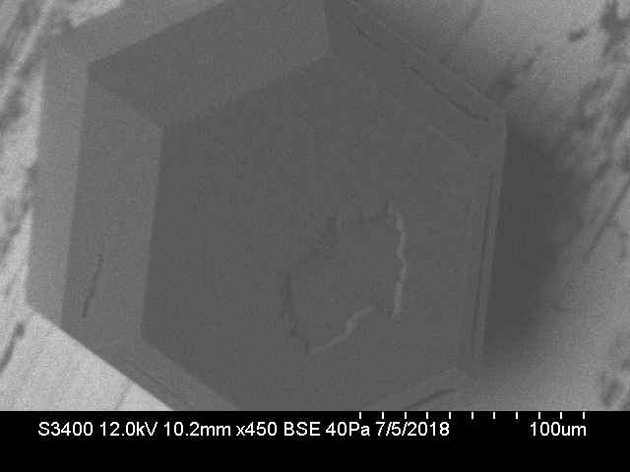
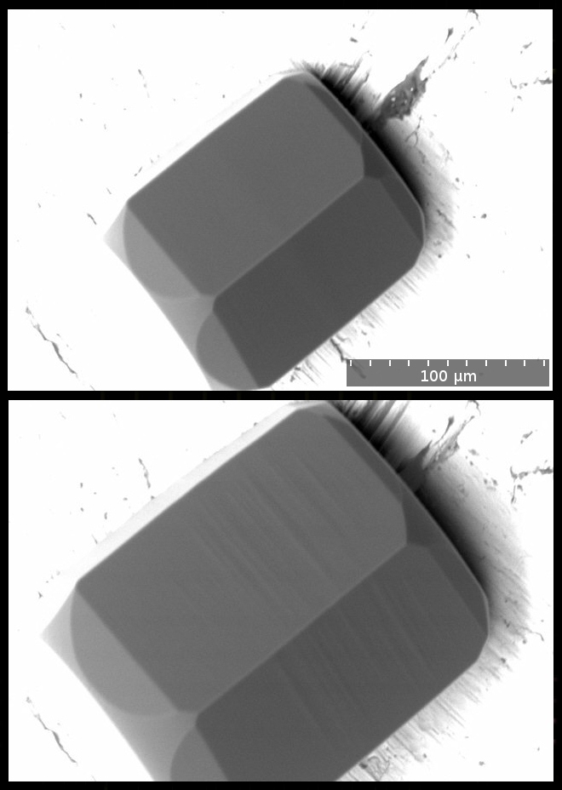
Basics of looking at an SEM image
Basal
Prismatic
Pyramidal
W. C. Pfalzgraff et al. 2009
Notes:
Scale Bar
Contrast/Brightness of Image
Facets

Slide 10
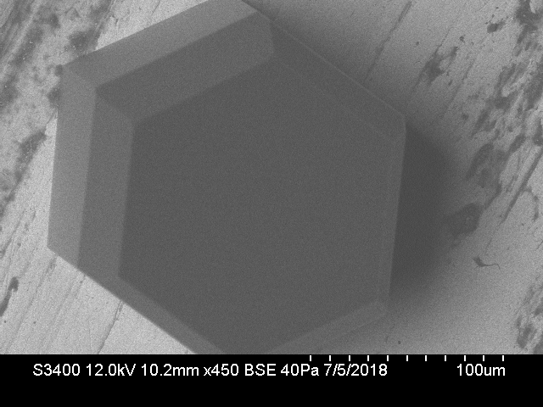
CALIBRATION
CALIBRATION
Find the normal vectors of each of the ice crystals
Use the normal to determine the backscatter light intensity variable
Create a y=mx+b line for the backscatter light intensity variable (s)
Notes:
Define a normal vector & demonstrate of the basal and pyramidal facets
The calibration process is dictated by the backscatter light intensity variable (which determines the brightness at each individual pixel), by determining the normal vectors of the facets we can regulate the position the facets sit at in order to create an s value not influenced by the tilt of the facets

Slide 11
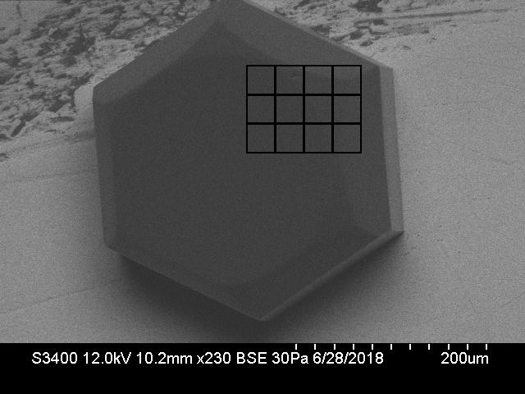
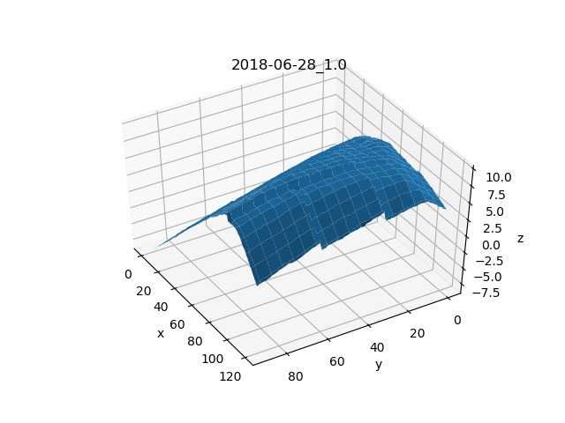
RETRIEVEL
…the fun part!
The goal of this retrieval was to create a model where we could look at the angle between the basal and pyramidal facets while seeing if the un-named raised circle would appear in the retrieval

Slide 12
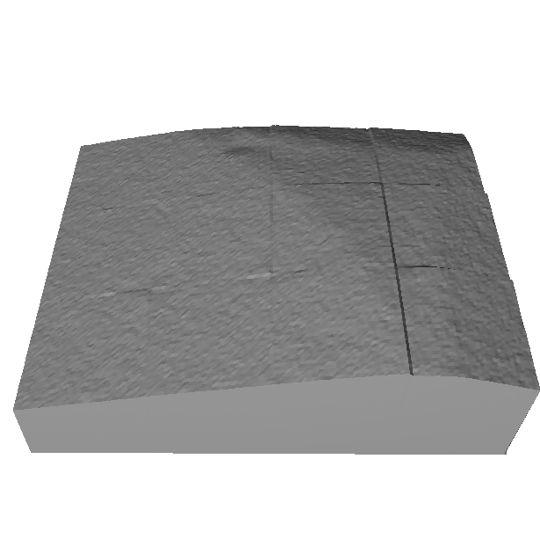
RETRIEVAL
Grid to .stl with skirt is the last of the python notebooks you will use
Takes the .npz format from the retrieval notebook and converts into .stl file for use in VR or the 3D printer

Slide 13
STL File [.stl]
FBX file
[.fbx]
Steam VR
Asset
3D Printer Interface
Blender
Unity
C# Assets
3D model
Movie
Project

Slide 14

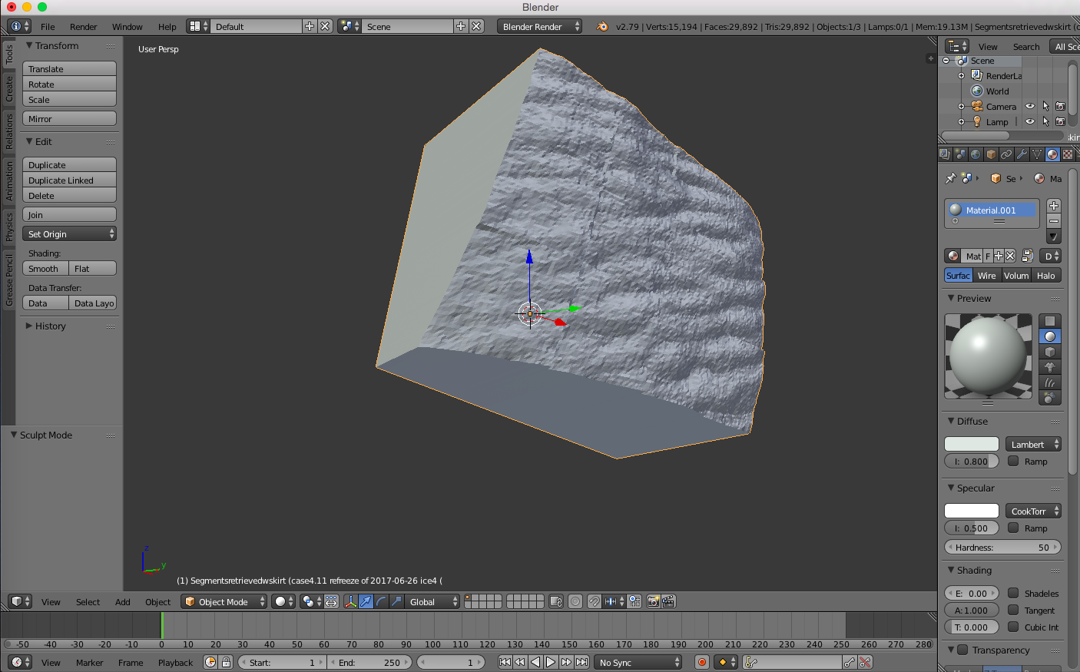
RETRIEVAL
Convert .stl files to .fbx files
3D computer graphics software
Unity supports the following:
Nodes with positions
Rotation
Scale
Names
Limitations in Unity:
Textures and diffuse colors are not assigned automatically

Slide 15
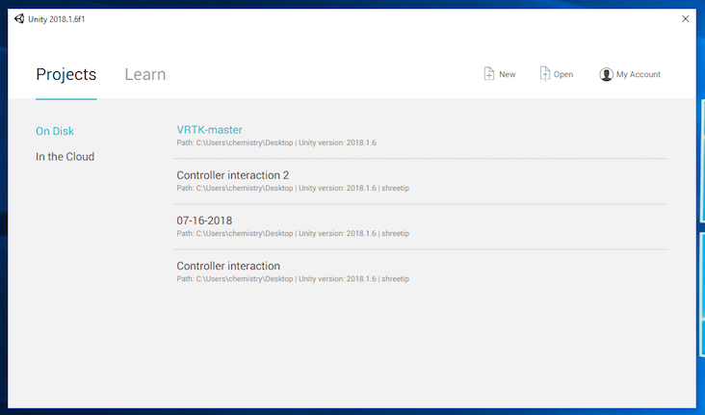

PROJECTS

Slide 16
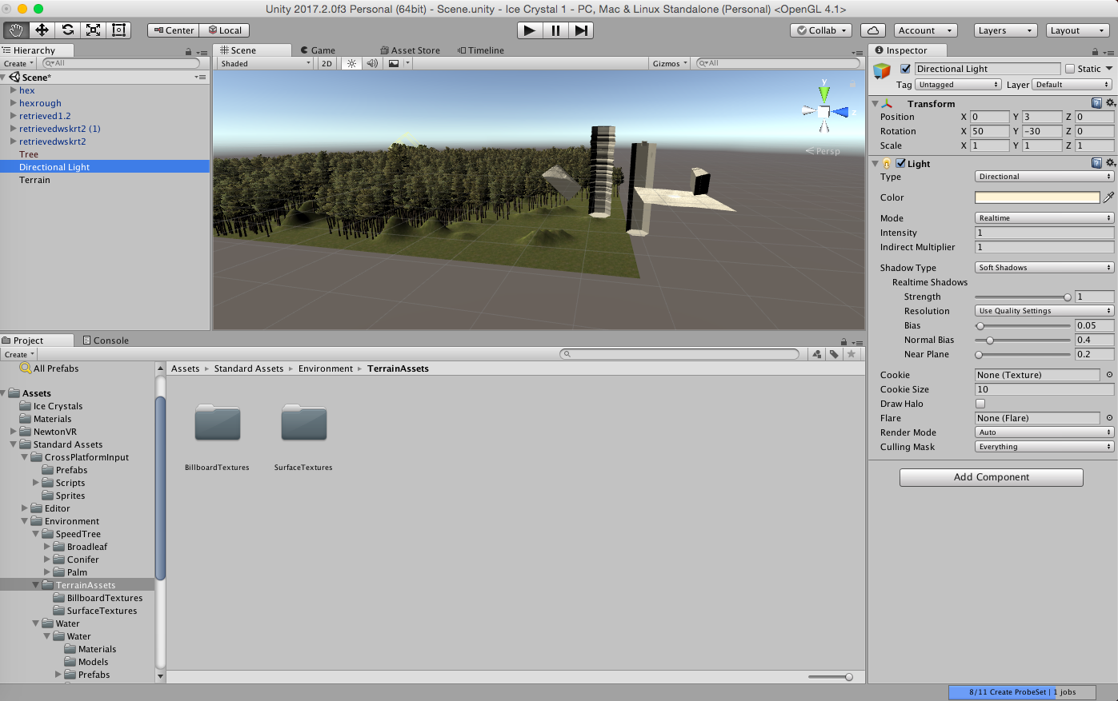

Slide 17
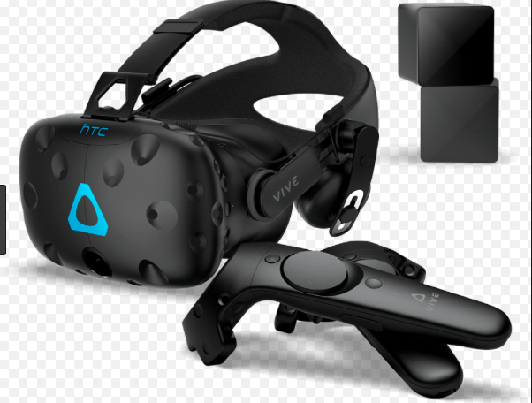
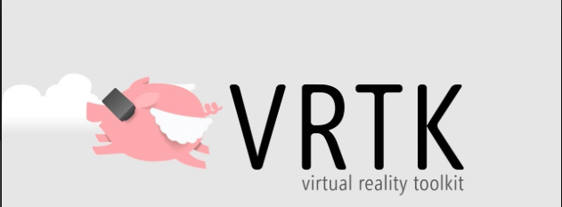
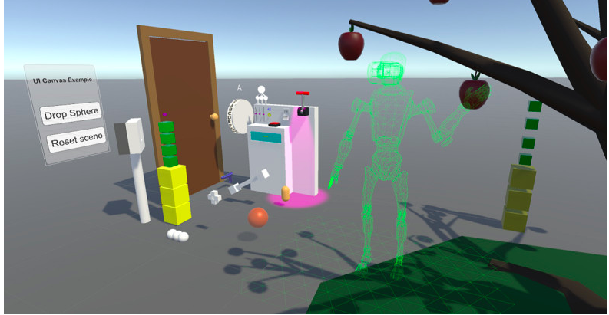
ASSETS
Steam VR
C# Code
https://www.vive.com/ca/enterprise/

